Slide 1
Project PTO – Building a Computer Algorithm to Predict the Oscars

Slide 2
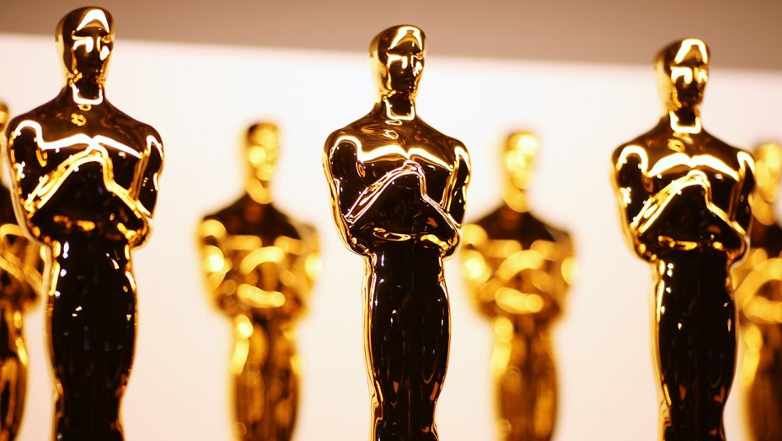

Slide 3
Overview
Method
Process
Takeaways

Slide 4
Results
Mode A: ML Algorithm
Mode B: Research Report

Slide 5
For the last 4 weeks, I developed a machine learning algorithm to predict the Oscars. Not just the winners, but also the nominees, in 6 categories: Best Picture, Leading Actor, Leading Actress, Supporting Actor, Supporting Actress, and Animated Film. I chose this project because I love movies and always watch the Oscars, and I’m pursuing CS major, so this project is the best of both worlds.
Data: Existing dataset + Web-scraping
Algorithm: Using Keras Functional API, MLP of hidden layer of 128 nodes w/ ReLU + 6 output layers of 3 nodes w/ Softmax
Results: 98.4% accuracy for the 2018 Oscars
Mentor: John Ciancutti, a Google director/scientist

Slide 6
1
2
3
4
Data Manipulation
/ Organization
Data Collection
Algorithm
Algorithm Optimization

Slide 7
Week 1: Data Collection
Met w/ mentor and narrowed down project from movie recommendation system to Oscar prediction algorithm
Found BIGML dataset
Web-scraped list of movies from IMDB
Week 2: Data Collection + Manipulation
Web-scraped input variables / details for all the movies collected (duration, certificate, IMDB rating, metascore, number of critic reviews, etc)
Web-scraped results on how movies did at previous award ceremonies (Golden Globes, BAFTA, Producers Guild, OFTA, etc)
Made point system for awards where winner = 1 point, nominee = 1/(number of nominees) point, nothing = 0 points
Incorporated into input feature vector
Week 3: Data Manipulation + Algorithm
Incorporated/organized all the web-scraped data into a dataset
Got rid of unnecessary data
Tried various ML classifiers: SVM, Decision Trees, Random Forests
Decided on neural network config
Week 4: Algorithm + Optimization
Not working properly w/ predicting results for 24 Oscar categories → simple version: win, nominee, or nothing?
Narrow down prediction to 6 Oscar categories due to lack of data
Dealing with imbalanced dataset, trying different model architectures (hidden layer size, loss functions, class weights, activation functions, etc)

Slide 8
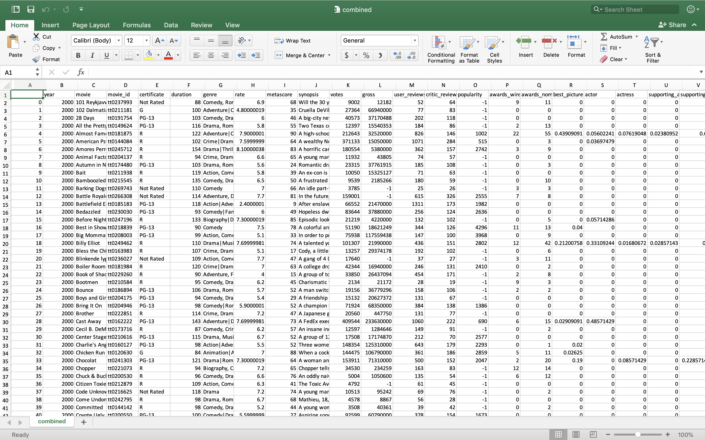

Slide 9
Plan out ahead / break it down
Always start with a simpler problem
Importance of data analysis
Ask as many questions as possible
Use a bigger font
Should keep good documentation
Chances are, someone already did it

Slide 10
https://github.com/j0hnk1m/predict-the-oscars
https://github.com/j0hnk1m/predict-the-oscars
https://github.com/j0hnk1m/predict-the-oscars
https://github.com/j0hnk1m/predict-the-oscars
https://github.com/j0hnk1m/predict-the-oscars
https://github.com/j0hnk1m/predict-the-oscars
https://github.com/j0hnk1m/predict-the-oscars
https://github.com/j0hnk1m/predict-the-oscars
https://github.com/j0hnk1m/predict-the-oscars
https://github.com/j0hnk1m/predict-the-oscars
https://github.com/j0hnk1m/predict-the-oscars
https://github.com/j0hnk1m/predict-the-oscars
https://github.com/j0hnk1m/predict-the-oscars
https://github.com/j0hnk1m/predict-the-oscars
https://github.com/j0hnk1m/predict-the-oscars
https://github.com/j0hnk1m/predict-the-oscars
https://github.com/j0hnk1m/predict-the-oscars
https://github.com/j0hnk1m/predict-the-oscars
https://github.com/j0hnk1m/predict-the-oscars
https://github.com/j0hnk1m/predict-the-oscars
https://github.com/j0hnk1m/predict-the-oscars
https://github.com/j0hnk1m/predict-the-oscars
https://github.com/j0hnk1m/predict-the-oscars
https://github.com/j0hnk1m/predict-the-oscars
https://github.com/j0hnk1m/predict-the-oscars
https://github.com/j0hnk1m/predict-the-oscars
https://github.com/j0hnk1m/predict-the-oscars
https://github.com/j0hnk1m/predict-the-oscars
https://github.com/j0hnk1m/predict-the-oscars
https://github.com/j0hnk1m/predict-the-oscars
https://github.com/j0hnk1m/predict-the-oscars
https://github.com/j0hnk1m/predict-the-oscars
https://github.com/j0hnk1m/predict-the-oscars
https://github.com/j0hnk1m/predict-the-oscars

